Slide 1
4 WAY TRAFFIC SIGNAL
Group Members:
Amjad Hussain
14k-2019
Mubashir latif
14k-2177
Muhammad Imran 14k-2204

Slide 2
INTRODUCTION
Traffic signals are used to control the flow of vehicles.
the need of transportation has gain immense importance for logistics as well as for common human
Traffic Signals provide an easy, cheap, automatic and justified solution
find a solution to this problem the concept of an automatic traffic controller is conceived

Slide 3
BASIC IDEA
The basic idea behind the design is to avoid the collision of vehicles
providing appropriate signals to different directions for a limited time slot.
This way a cycle will be established which will control the traffic.

Slide 4
CONTROL SIGNALS
The control signals are 3-lights.
Top light is Red(Stop),¬ Middle light is Yellow(Wait)¬ Bottom light is Green(Go).
a minimum of 4-states are possible for which different vehicles will pass through

Slide 5
COMPONENT
Component Name
555 timer 1
CD IC 4017 1
Resistors 4
Capacitor 2
Diode 8
LED’s 12
Battery (5v)

Slide 6
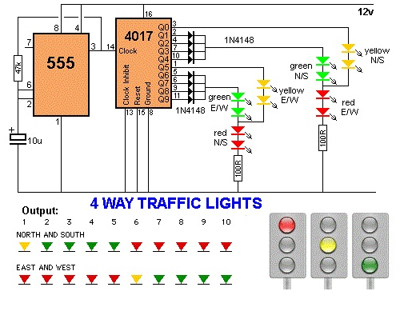
CIRCUIT DIAGRAM

Slide 7
WORKING PRINCIPAL
A highly stable device for generating accurate time delays or oscillation.
In this Automated Traffic Signal Controller, Timer 555 is used as an Astable Multivibrator to generate clock
Synchronous Decade Counter Count from 0 to 9 (0000 to 1001 in binary).
the reset, preset, countÃ‚Â enable and carryÃ‚Â in inputs should all be high.

Slide 8
WORKING PRINCIPAL
When countÃ‚Â enable is low, the clock input is ignored and counting stops.
The counter may be preset by placing the desired binary number on the inputsÃ‚Â A-D
making the preset input low, and applying a positive pulse to the clock input.

Slide 9
ADVANTAGE
Reduction in normal recurring.
Significantly enhanced operational tools congestion to
effectively manage traffic incidents.
It improved public transport service.
Reduction in emergency response times and safer travel.

Slide 10
ADVANTAGE
Improve traffic guidance and traffic flow
Reduce fuel consumption
Increase safety They increase the traffic-handling capacity of the intersection
Less cost

Slide 11
DISADVANTAGE
Excessive delay may be caused.
These unnecessary delay results in significant fuel waste and higher motorist costs.
Disobedience of signals

Slide 12
APPLICATIONS
Heavy traffic roads
Fire station or medical emergency entrance.
at the entrance and exit of some car washes
In airplanes

